Slide 1
Data Structure & Algorithm
Session 11
Searching – Sorting Algorithms

Slide 2
Objectives
Search Algorithms
Linear search
Binary search
Sort Algorithms
Bubble sort
Insertion sort
Selection sort
Quick sort

Slide 3
Introduction to searching
Searching is the process of finding some particular element in the list. If the element is present in the list, then the process is called successful, otherwise the search is called unsuccessful.
Searching may be sequential or not. If the data in the dataset are random, then we need to use sequential searching. Otherwise we can use other different techniques to reduce the complexity.
There are two popular search methods that are widely used in order to search some item into the list:
Linear Search
Binary Search

Slide 4
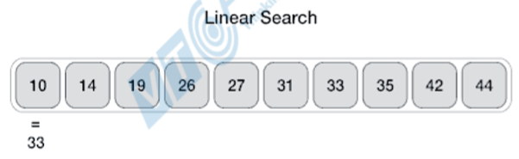
Linear search
Linear or Sequential Search is the simplest of search algorithms. While it most certainly is the simplest, it's most definitely not the most common, due to its inefficiency. It's a brute-force algorithm. Very rarely is it used in production, and in most cases, it's outperformed by other algorithms.
Linear Search has no pre-requisites for the state of the underlying data structure.
Linear Search involves sequential searching for an element in the given data structure until either the element is found or the end of the structure is reached.
Notes:
If the element is found, we usually just return its position in the data structure. If not, we usually return -1.

Slide 5
Complexity of Linear search Algorithm
LINEAR_SEARCH(A, N, VAL)
Step 1: [INITIALIZE] SET POS = -1
Step 2: [INITIALIZE] SET I = 1
Step 3: Repeat Step 4 while I<=N
Step 4:
IF A[I] = VAL
SET POS = I
PRINT POS
Go to Step 6
[END OF IF]
SET I = I + 1
[END OF LOOP]
Step 5:
IF POS = -1
PRINT " VALUE IS NOT PRESENTIN THE ARRAY "
[END OF IF]
Step 6: EXIT
Complexity | Best Case | Average Case | Worst Case
Time | O(1) | O(n) | O(n)
Space |  |  | O(1)

Slide 6
Linear search
Example
=========================
Input : arr[] = {10, 20, 80, 30, 60, 50,
110, 100, 130, 170}
x = 110;
Output : 6
Element x is present at index 6
=========================
Input : arr[] = {10, 20, 80, 30, 60, 50,
110, 100, 130, 170}
x = 175;
Output : -1
Element x is not present in arr[].

Slide 7
Linear search
public class LinearSearchExample{
public static int linearSearch(int[] arr, int key){
for(int i=0;i<arr.length;i++){
if(arr[i] == key){
return i;
}
}
return -1;
}
public static void main(String a[]){
int[] a1= {10,20,30,50,70,90};
int key = 50;
int pos = linearSearch(a1, key);
if (pos>=0)
System.out.println(key+" is found at index: "+pos);
else
System.out.println(key+" not found");
}
}
Output:
50 is found at index: 3

Slide 8
Linear search
import java.util.Scanner;
class LinearSearchExample2 {
public static void main(String args[]) {
int c, n, search, array[];
Scanner in = new Scanner(System.in);
System.out.println("Enter number of elements: "); n = in.nextInt(); array = new int[n];
System.out.println("Enter those " + n + " elements: ");
for (c = 0; c < n; c++)
array[c] = in.nextInt();
System.out.println("Enter value to find: "); search = in.nextInt();
for (c = 0; c < n; c++) {
if (array[c] == search) { /* Searching element is present */
System.out.println(search + " is present at location " + (c + 1) + ".");
break;
}
}
if (c == n) /* Element to search isn't present */
System.out.println(search + " isn't present in array.");
}
}

Slide 9
Binary search
Binary or Logarithmic Search is one of the most commonly used search algorithms primarily due to its quick search time, it requires the data set to be sorted beforehand.
Binary search algorithms typically halve the number of items to check with each successive iteration, thus locating the given item (or determining its absence) in logarithmic time.

Slide 10
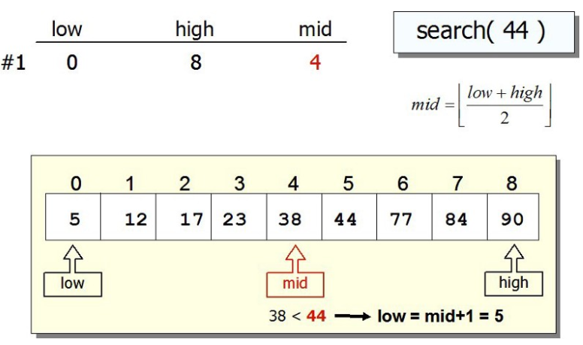
Binary search
Notes:
Binary searching works by comparing an input value to the middle element of the array:
When the element being compared equals the input, the search stops and typically returns the position of the element.
If the element is not equal to the input, then a comparison is made to determine whether the input is less than or greater than the element. Depending on which it is, the algorithm then starts over, but only searching the top or a bottom subset of the array's elements.
If the input is not located within the array, the algorithm will usually output a unique value (-1) indicating this.

Slide 11
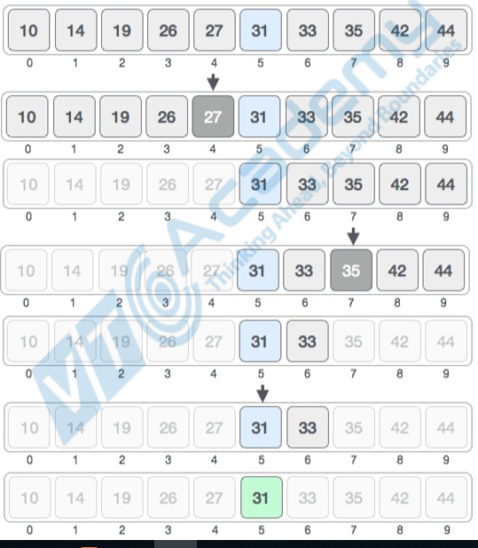
Binary search

Slide 12
Complexity of Binary search Algorithm
BINARY_SEARCH(A, lower_bound, upper_bound, VAL)
Step 1: [INITIALIZE] SET BEG = lower_bound, END = upper_bound, POS = - 1
Step 2: Repeat Steps 3 and 4 while BEG <=END
Step 3: SET MID = (BEG + END)/2
Step 4:
IF A[MID] = VAL
SET POS = MID
PRINT POS
Go to Step 6
ELSE IF A[MID] > VAL
SET END = MID - 1
ELSE
SET BEG = MID + 1
[END OF IF]
[END OF LOOP]
Step 5:
IF POS = -1
PRINT "VALUE IS NOT PRESENT IN THE ARRAY"
[END OF IF]
Step 6: EXIT
No | Performance | Complexity
1 | Worst case | O(log n)
2 | Best case | O(1)
3 | Average Case | O(log n)
4 | Worst case space complexity | O(1)

Slide 13
Binary search
class BinarySearchExample{
public static int binarySearch(int arr[], int first, int last, int key){
int mid = (first + last)/2;
while( first <= last ){
if ( arr[mid] < key ) first = mid + 1;
else if ( arr[mid] == key ) return mid;
else last = mid - 1;
mid = (first + last)/2;
}
if ( first > last ) return -1;
}
public static void main(String args[]){
int arr[] = {10,20,30,40,50};
int key = 30;
int last=arr.length-1;
int pos = binarySearch(arr,0,last,key);
if(pos>=0) System.out.println("Element is found at index: " + mid);
else System.out.println("Element is not found!");
}
}
Output:
Element is found at index: 2

Slide 14
Binary search example using Recursion
class BinarySearchExample1{
public static int binarySearch(int arr[], int first, int last, int key){
if (last>=first){
int mid = first + (last - first)/2;
if (arr[mid] == key)
return mid;
else if (arr[mid] > key) return binarySearch(arr, first, mid-1, key);//search in left subarray
else return binarySearch(arr, mid+1, last, key);//search in right subarray
}
return -1;
}
public static void main(String args[]){
int arr[] = {10,20,30,40,50};
int key = 30;
int last=arr.length-1;
int pos = binarySearch(arr,0,last,key);
if(pos>=0) System.out.println("Element is found at index: " + mid);
else System.out.println("Element is not found!");
}
}
Output:
Element is found at index: 2

Slide 15
Binary search example using Arrays.binarySearch()
import java.util.Arrays;
class BinarySearchExample2{
public static void main(String args[]){
int arr[] = {10,20,30,40,50};
int key = 30;
int result = Arrays.binarySearch(arr,key);
if (result < 0)
System.out.println("Element is not found!");
else
System.out.println("Element is found at index: "+result);
}
}
Output:
Element is found at index: 2

Slide 16
Introduction to sorting
Sorting is nothing but arranging the data in ascending or descending order.
Since the beginning of the programming age, computer scientists have been working on solving the problem of sorting by coming up with various different algorithms to sort data.
The two main criterias to judge which algorithm is better than the other have been:
Time taken to sort the given data.
Memory Space required to do so.
There are various sorting algorithms, some common sorting methods:
Bubble Sort
Insertion Sort
Selection Sort
Quick sort
Notes:
There are so many things in our real life that we need to search for, like a particular record in database, roll numbers in merit list, a particular telephone number in telephone directory, a particular page in a book etc.
All this would have been a mess if the data was kept unordered and unsorted, but fortunately the concept of sorting came into existence, making it easier for everyone to arrange data in an order, hence making it easier to search

Slide 17
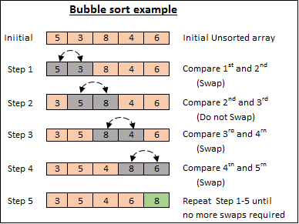
Bubble sort
Notes:
Bubble sort works by swapping adjacent elements if they're not in the desired order. This process repeats from the beginning of the array until all elements are in order.
We know that all elements are in order when we manage to do the whole iteration without swapping at all - then all elements we compared were in the desired order with their adjacent elements, and by extension, the whole array.
The worst case time complexity would be O(n^2) with n is size of array.

Slide 18
Bubble sort
Algorithm :
Step 1: Repeat Step 2 For i = 0 to N-1
Step 2: Repeat For J = i + 1 to N - I
Step 3:
IF A[J] > A[i]
SWAP A[J] and A[i]
[END OF INNER LOOP]
[END OF OUTER LOOP
Step 4: EXIT
Complexity:
Scenario | Complexity
Space | O(1)
Worst case running time | O(n²)
Average case running time | O(n)
Best case running time | O(n²)

Slide 19
Bubble sort example
public class BubbleSortExample {
static void bubbleSort(int[] arr) {
int n = arr.length;
int temp = 0;
for(int i=0; i < n; i++){
for(int j=1; j < (n-i); j++){
if(arr[j-1] > arr[j]){
//swap elements
temp = arr[j-1];
arr[j-1] = arr[j];
arr[j] = temp;
}
}
}
}
public static void main(String[] args) {
int arr[] ={3,60,35,2,45,320,5};
System.out.println("Array Before Bubble Sort");
for(int i=0; i < arr.length; i++){
System.out.print(arr[i] + " ");
}
System.out.println();
bubbleSort(arr);//sorting array elements using bubble sort
System.out.println("Array After Bubble Sort");
for(int i=0; i < arr.length; i++){
System.out.print(arr[i] + " ");
}
}
}
Output:
Array Before Bubble Sort
3 60 35 2 45 320 5
Array After Bubble Sort
2 3 5 35 45 60 320

Slide 20
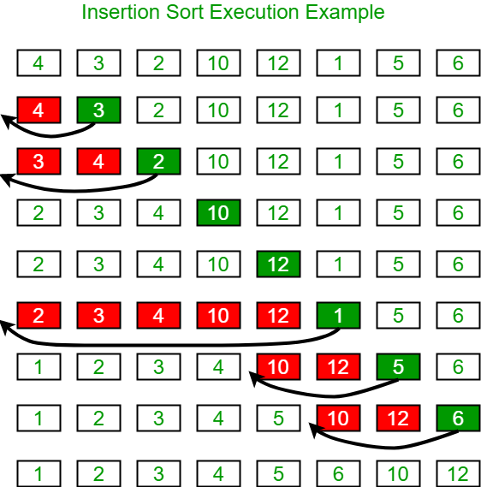
Insertion sort
Notes:
The idea behind Insertion Sort is dividing the array into the sorted and unsorted subarrays.
The sorted part is of length 1 at the beginning and is corresponding to the first (left-most) element in the array. We iterate through the array and during each iteration, we expand the sorted portion of the array by one element.
Upon expanding, we place the new element into its proper place within the sorted subarray. We do this by shifting all of the elements to the right until we encounter the first element we don't have to shift.
This is because in each iteration, we'll have to move the whole sorted list by one, which is O(n). We have to do this for each element in every array, which means it's going to be bounded by O(n^2).

Slide 21
Insertion sort
Algorithm
Step 1: Repeat Steps 2 to 5 for K = 1 to N-1
Step 2: SET TEMP = ARR[K]
Step 3: SET J = K - 1
Step 4:
Repeat while TEMP <=ARR[J]
SET ARR[J + 1] = ARR[J]
SET J = J - 1
[END OF INNER LOOP]
Step 5:
SET ARR[J + 1] = TEMP
[END OF LOOP]
Step 6: EXIT
Complexity
Complexity | Best Case | Average Case | Worst Case
Time | Ω(n) | θ(n²) | o(n²)
Space |  |  | o(1)

Slide 22
Insertion sort example
public class InsertionSortExample {
public static void insertionSort(int array[]) {
int n = array.length;
for (int j = 1; j < n; j++) {
int key = array[j];
int i = j-1;
while ( (i > -1) && ( array [i] > key ) ) {
array [i+1] = array [i];
i--;
}
array[i+1] = key;
}
}
public static void main(String a[]){
int[] arr1 = {9,14,3,2,43,11,58,22};
System.out.println("Before Insertion Sort");
for(int i:arr1){
System.out.print(i+" ");
}
System.out.println();
insertionSort(arr1);//sorting array using insertion sort
System.out.println("After Insertion Sort");
for(int i:arr1){
System.out.print(i+" ");
}
}
}
Output:
Before Insertion Sort
9 14 3 2 43 11 58 22
After Insertion Sort
2 3 9 11 14 22 43 58

Slide 23
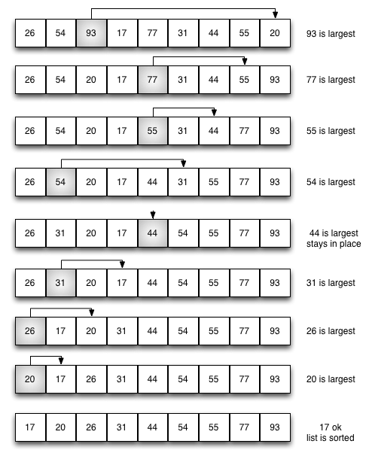
Selection sort
Notes:
Selection Sort also divides the array into a sorted and unsorted subarray. Though, this time, the sorted subarray is formed by inserting the minimum element of the unsorted subarray at the end of the sorted array.
Finding the minimum is O(n) for the length of array because we have to check all of the elements. We have to find the minimum for each element of the array, making the whole process bounded by O(n^2).

Slide 24
Selection sort
Algorithm
SELECTION SORT(ARR, N)
Step 1: Repeat Steps 2 and 3 for K = 1 to N-1
Step 2: CALL SMALLEST(ARR, K, N, POS)
Step 3:
SWAP A[K] with ARR[POS]
[END OF LOOP]
Step 4: EXIT
SMALLEST (ARR, K, N, POS)
Step 1: [INITIALIZE] SET SMALL = ARR[K]
Step 2: [INITIALIZE] SET POS = K
Step 3: Repeat for J = K+1 to N -1
IF SMALL > ARR[J]
SET SMALL = ARR[J]
SET POS = J
[END OF IF]
[END OF LOOP]
Step 4: RETURN POS
Complexity
Complexity | Best Case | Average Case | Worst Case
Time | Ω(n) | θ(n²) | o(n²)
Space |  |  | o(1)

Slide 25
Selection sort example
public class SelectionSortExample {
public static void selectionSort(int[] arr){
for (int i = 0; i < arr.length - 1; i++)
{
int index = i;
for (int j = i + 1; j < arr.length; j++){
if (arr[j] < arr[index]){
index = j;//searching for lowest index
}
}
int smallerNumber = arr[index];
arr[index] = arr[i];
arr[i] = smallerNumber;
}
}
public static void main(String a[]){
int[] arr1 = {9,14,3,2,43,11,58,22};
System.out.println("Before Selection Sort");
for(int i:arr1){
System.out.print(i+" ");
}
System.out.println();
selectionSort(arr1);//sorting array using selection sort
System.out.println("After Selection Sort");
for(int i:arr1){
System.out.print(i+" ");
}
}
}
Output:
Before Selection Sort
9 14 3 2 43 11 58 22
After Selection Sort
2 3 9 11 14 22 43 58

Slide 26
Selection sort example
public class SelectionSortSmallestExample {
public static int smallest(int a[], int n, int i) {
int small,pos,j;
small = a[i];
pos = i;
for(j=i+1;j<10;j++)
{
if(a[j]<small)
{
small = a[j];
pos=j;
}
}
return pos;
}
public static void main(String a[]){
int[] a = {10, 9, 7, 101, 23, 44, 12, 78, 34, 23};
int i,j,k,pos,temp;
for(i=0;i<10;i++)
{
pos = smallest(a,10,i);
temp = a[i];
a[i]=a[pos];
a[pos] = temp;
}
System.out.println("\nprinting sorted….\n");
for(i=0;i<10;i++) {
System.out.print(a[i]+" ");
}
}
}
Output:
printing sorted….
7 9 10 12 23 23 34 44 78 101

Slide 27
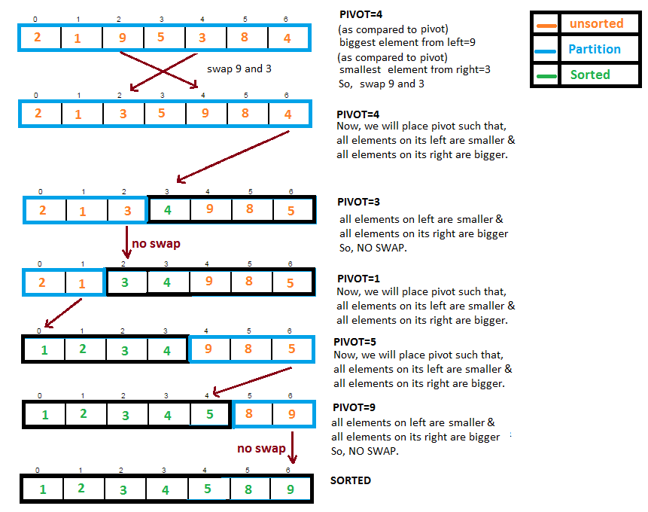
Quick sort

Slide 28
Quick sort
Quick sort is a highly efficient sorting algorithm, it is a divide and conquer algorithm. It first divides a large list into two smaller sub-lists and then recursively sort the two sub-lists.
If we want to sort an array without any extra space, quicksort is a good option. On average, time complexity is O(nlog(n)) and worst case complexity are of Ο(n²).
The basic step of sorting an array are as follows:
Select a pivot
Move smaller elements to the left and move bigger elements to the right of the pivot
Recursively sort left part and right part
There are many different versions of Quick sort that pick pivot in different ways.
Always pick first element as pivot.
Always pick last element as pivot.
Pick a random element as pivot.
Pick median as pivot.

Slide 29
Quick sort
Algorithm: quicksort(ARR, LOW, HIGH)
//partition of ARR
Step 1:
SET pivot = ARR[k] // with LOW<=k<=HIGH
SET I = LOW
SET J = HIGH
Step 2: Repeat while I<=J
Repeat while ARR[I]<pivot
SET I = I + 1
[END OF INNER LOOP]
Repeat while ARR[J]>pivot
SET J = J - 1
[END OF INNER LOOP]
IF I<=J
SWAP ARR[I] AND ARR[J}
SET I = I+1
SET J = J+1
[END OF IF]
[END OF LOOP]
//recursively sort two sub parts
Step 3:
IF LOW < J
CALL quicksort(ARR, LOW, J)
[END OF IF]
Step 4:
IF I < HIGH
CALL quicksort(ARR, I, HIGH)
[END OF IF]
Step 5: EXIT
Complexity | Best Case | Average Case | Worst Case
Time Complexity | O(n) for 3 way partition or O(n log n) simple partition | O(n log n) | O(n²)
Space Complexity |  |  | O(log n)

Slide 30
Quick sort
public class QuickSort {
public static void main(String[] args) {
int[] x = { 9, 2, 4, 7, 3, 7, 10 };
System.out.println(Arrays.toString(x));
int low = 0, high = x.length - 1;
quickSort(x, low, high);
System.out.println(Arrays.toString(x));
}
public static void quickSort(int[] arr, int low, int high) {
if (arr == null || arr.length == 0) return;
if (low >= high) return;
// pick the pivot
int middle = (low + high) / 2;
int pivot = arr[middle];
// make left < pivot and right > pivot
int i = low, j = high;
while (i <= j) {
while (arr[i] < pivot) i++;
while (arr[j] > pivot) j--;
if (i <= j) {
int temp = arr[i];
arr[i] = arr[j];
arr[j] = temp;
i++;
j--;
}
}
// recursively sort two sub parts
if (low < j) quickSort(arr, low, j);
if (high > i) quickSort(arr, i, high);
}//end of quickSort
}//end of class
Output:
9 2 4 7 3 7 10 2 3 4 7 7 9 10

Slide 31
Summary
Linear or Sequential Search is the simplest of search algorithms. In Linear search, we will traverse the array from the starting, till the desired element or value is found. It has a time complexity of O(n)
Binary or Logarithmic Search is one of the most commonly used search algorithms primarily due to its quick search time (complexity of O(log n)), it requires the data set to be sorted beforehand.
Bubble sort works by swapping adjacent elements if they're not in the desired order and repeats from the beginning of the array until all elements are in order. The worst case time complexity would be O(n²).
Selection Sort also divides the array into a sorted and unsorted subarray. Though, this time, the sorted subarray is formed by inserting the minimum element of the unsorted subarray at the end of the sorted array, whole process bounded by O(n²).
Quick sort is a highly efficient sorting algorithm, it is a divide and conquer algorithm. It first divides a large list into two smaller sub-lists and then recursively sort the two sub-lists. If we want to sort an array without any extra space, quicksort is a good option. On average, time complexity is O(nlog(n)) and worst case complexity are of Ο(n²).

Slide 32
References
https://www.javatpoint.com/linear-search-in-java
https://www.geeksforgeeks.org/java-program-for-linear-search/
https://www.javatpoint.com/binary-search-in-java
https://www.geeksforgeeks.org/binary-search-in-java/
https://stackabuse.com/sorting-algorithms-in-java/
https://stackabuse.com/search-algorithms-in-java/
https://www.geeksforgeeks.org/sorting-algorithms/
http://www.javawithus.com/tutorial/searching-and-sorting-arrays
https://www.geeksforgeeks.org/bubble-sort/
https://www.geeksforgeeks.org/selection-sort/
https://www.geeksforgeeks.org/insertion-sort/
https://www.programcreek.com/2012/11/quicksort-array-in-java/
https://www.geeksforgeeks.org/quick-sort/
https://www.baeldung.com/java-quicksort

Slide 33


